Slide 1
Customer segmentation analysis
SRI SIRI JAMI
sirijami1231@gmail.com

Slide 2
Customer segmentation and it’s insights
Projects Goals
Methodology
Cluster Analysis
Insights and Recommendations
SUMMARY

Slide 3
PROJECT GOAL
The goal of this project is to assist mohkart, a leading ecommerce player in india, in deriving actionable customer insights. This information will empower them to create customer segment-specific strategies, ultimately optimizing their operations and marketing campaigns.

Slide 4
Methodology
Data Acquisition
Data Preprocessing
Customer Profiling
Insights Generation
Storytelling and Visualization
Attributes like Customer Id, Age, Device, City, Price, Quantity, Purchase Date, Browsing Time
Handling Missing Values, Statistical Summary, Encoding
Employ KMeans Clustering to Customers
Analyzing spending and patterns

Slide 5
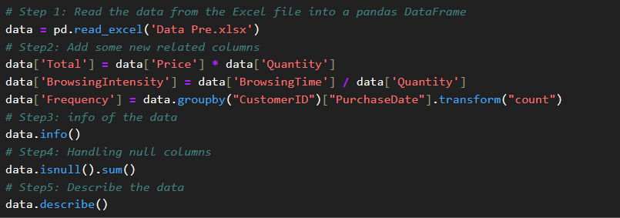
Data preprocessing
These are some of the steps involved in data preprocessing process such as
loading the data,
creating new suitable columns,
knowing the brief (no. of rows, columns, null values, datatype of column),
descriptive analysis of data,
Handling null values if present.

Slide 6
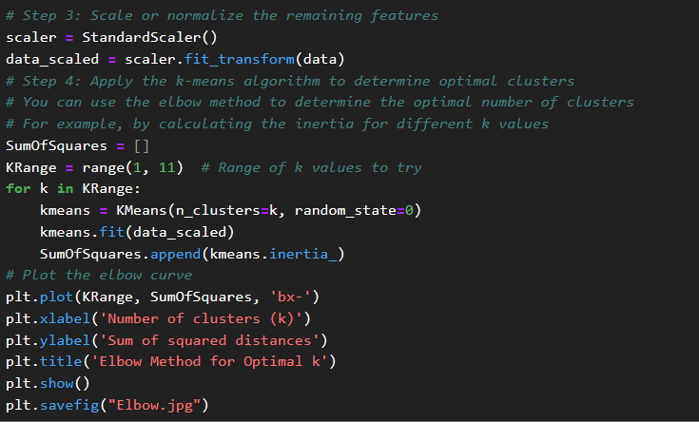
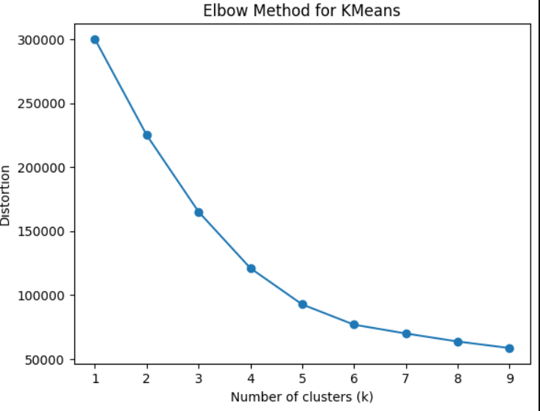
Cluster analysis
Elbow Method is used to determine the number of optimal clusters (k) , which will require for customer segmentation of KMeans clustering .
As we see the plot of elbow , it is difficult to determine the ‘k’ = 9 as the dataset given widely spread with less commonalities, so for better reference , silhouette score is to be calculated.

Slide 7
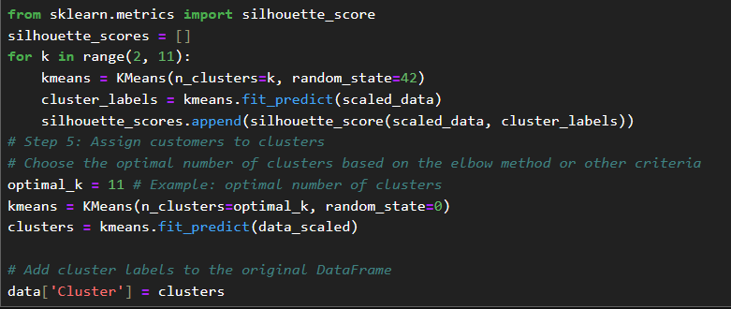
Silhouette Score and KMeans
Here, the calculated Silhouette Score is 0.319677 which means weak clustering and optimal k is 12.
So, from elbow method k = 9 and Silhouette score k = 12 and optimal clusters is 11.
After, determining the k ., import the KMeans module and fit_predict the method.
Then add column name as clusters to the data by using kmeans.labels_.

Slide 8
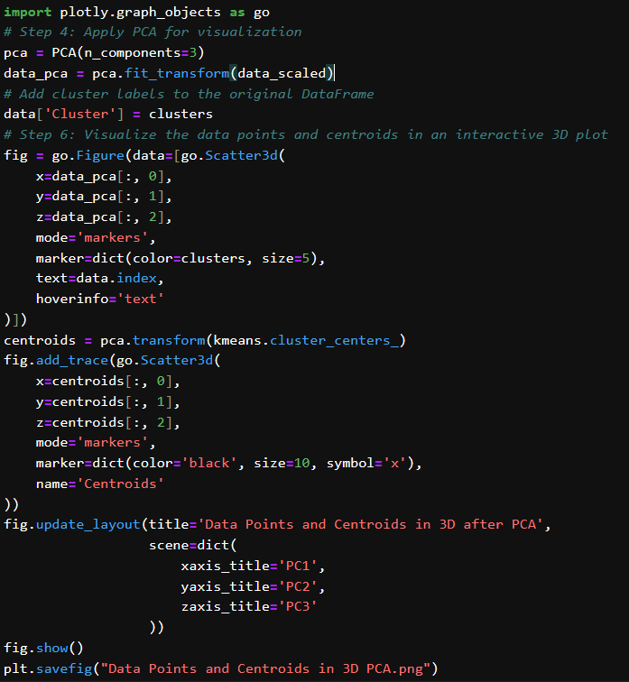
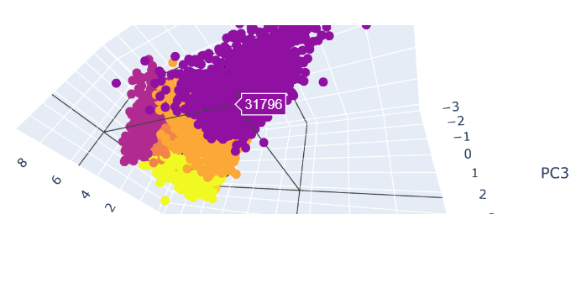
PCA Visualization
Due to weak clustering , PCA helps to reduce the dimensionality and preserve the essential information, also allows us to visualize the data in lower dimensionality space.

Slide 9
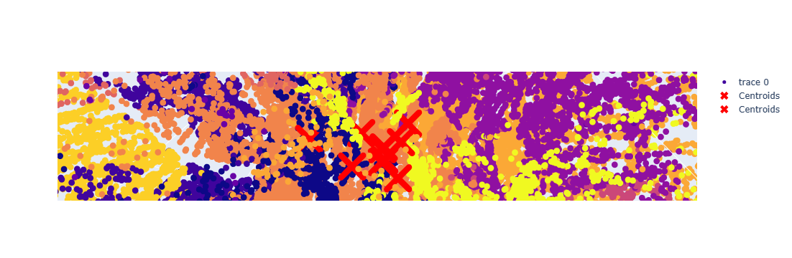
PCA Visualization (3D) , its centroids

Slide 10
Insights and Recommendations
By analyzing the clustered data, we can extract valuable insights that will translate into actionable recommendations for Mohkart. Here are some potential examples:
High - Value Customers: Clusters with high spending and target them with personalized marketing campaigns like exclusive discounts or curated products recommendations.
Low – Engagement Customers: Clusters with potentially lower engagement i.e., lower spending, high browsing abandonment). By investigating the website usability, product page performance, and consider to introductory discounts to boost engagement.
Personalization: Leveraging browsing behavior and purchase history to create personalized product recommendations. This could involve suggesting complementary products based on past purchases or recommending similar items to customers who spend a significant amount of time browsing specific categories.

Slide 11
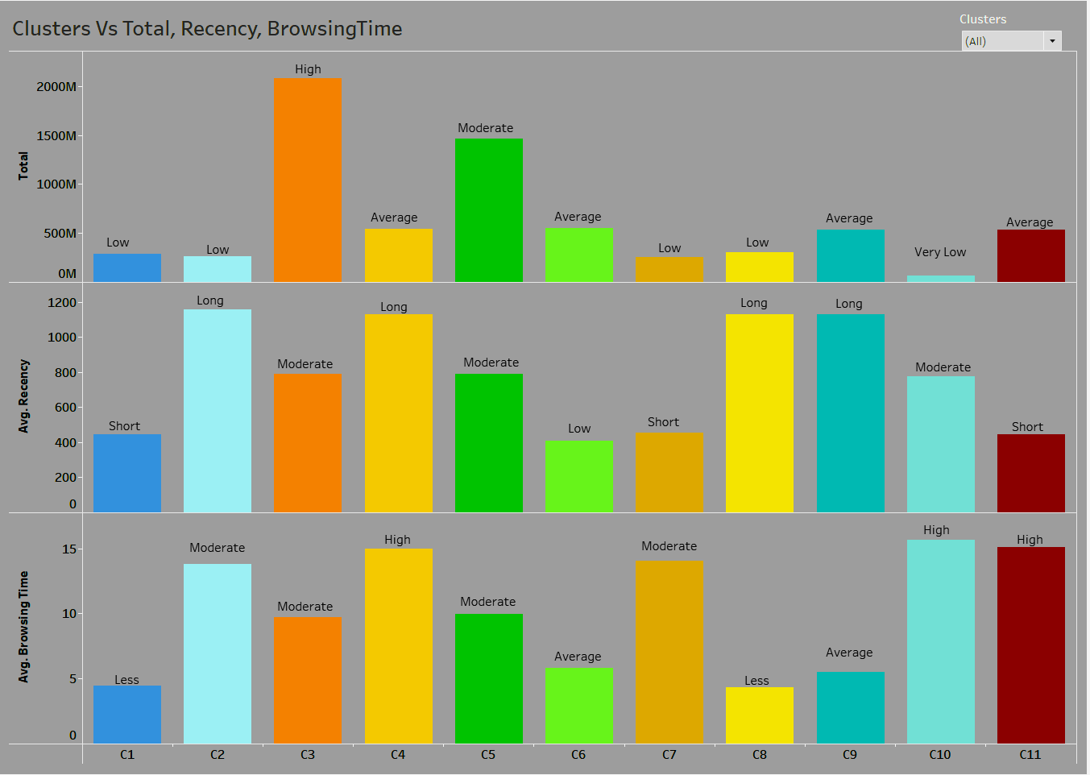
Visualization1: For Clusters, comparing the Sum(Total_Amount), Avg(Recency, Browsing Time)
Spenders:
High (C3, C5)
Average( C4,C6,C9)
Low (C1,C2,C7)
Very Low( C10)
Recency:
Long (C2,C4,C8,C9)
Moderate (C3,C5,C10)
Short (C1, C6,C7,C11)
Browsing Time
High (C4,C10,C11)
Moderate (C2,C3,C5)
Average (C6,C9)
Less (C1, C8)

Slide 12
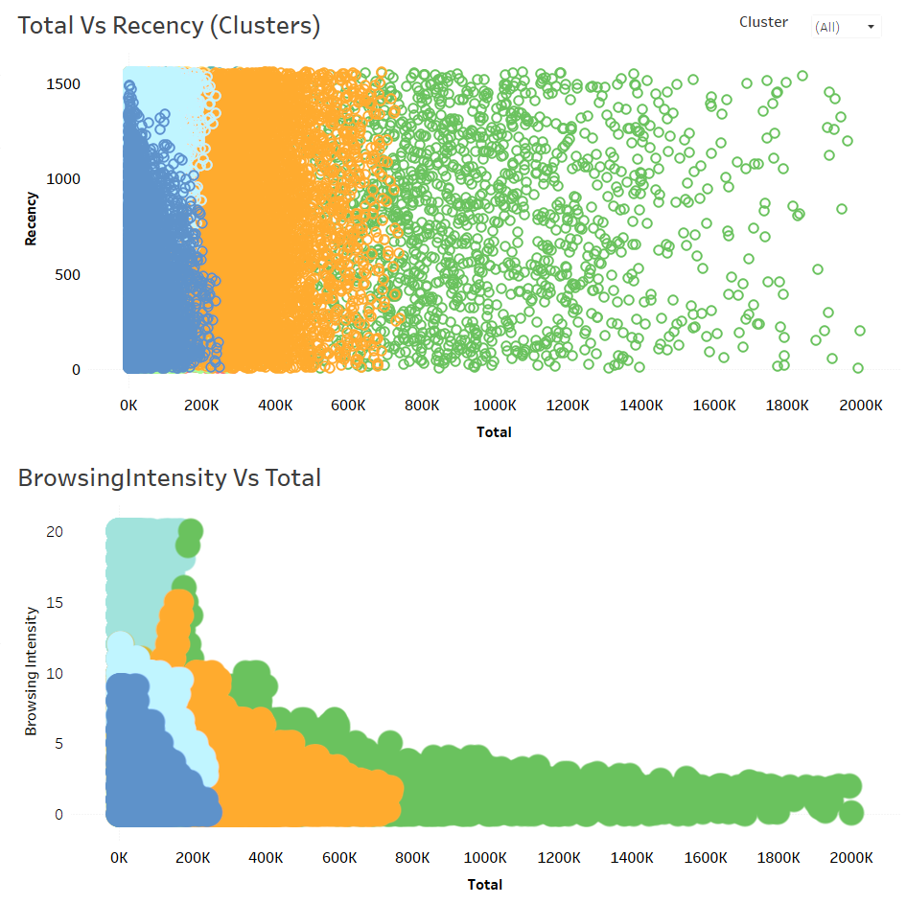
Visualization 2:
From this Image, we can observe the relationship between total_amount and recency, browsing time for Clusters.

Slide 13
SUMMARY
This project will equip Mohkart with Valuable customer segmentation and behavioral insights. By leveraging these insights, they can refine their marketing strategies, optimize website engagement, and ultimately drive customer satisfaction and loyalty. The combination of customer profiling , cluster analysis, and data visualization will be key in unlocking these valuable business insights.
Cluster Analysis:
For this given dataset,
the data shown as weak clustering which may due to Inherent variability such as some data points may share characteristics of multiple clusters, leading to weak .
Also, May be clause of overlapping patterns and customers with mixed behaviors.
So, When trying the hierarchical clustering , it causing the memory error and KMeans clustering, taken the more optimal clusters for better customer segmentation
As per Visualizing the clustered data:
High spenders spent moderate time on browsing the products - Cluster 3
Frequent buyers have shorter recency such as customers who purchase often – Cluster 6
Analyze Spending habits:
Clusters with high average total amount and purchase frequency – Who are potentially high value customers.

